Slide 1



EEG Modeling Project: IFD Update
March 15th, 2023
By: Elizabeth Nemeti
Instructed by: Dr Sameni

Slide 2
1
Recap on EEG
Combine the interpretability of physics-based models with the generalizability of machine learning models.
Electroencephalography (EEG) is a crucial tool in the diagnosis and management of epilepsy, a neurological disorder characterized by recurrent seizures. However, the availability of real EEG data is often limited. This is where synthetic EEG signals come in.
Generate a large dataset of synthetic EEG signals. These signals will then be used to train a machine learning model to detect the preictal and ictal states in EEG signals.
Department of
Biomedical Informatics

Slide 3
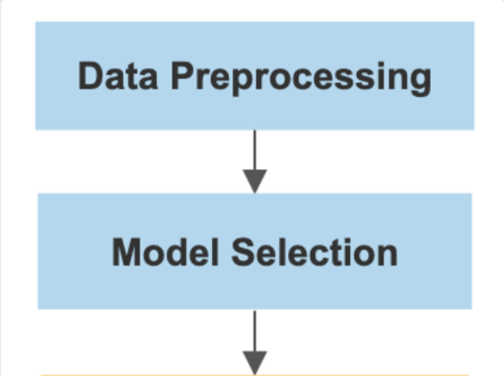
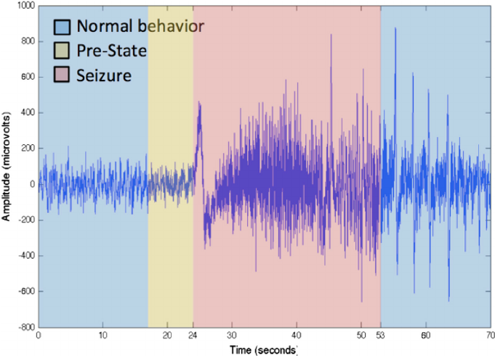
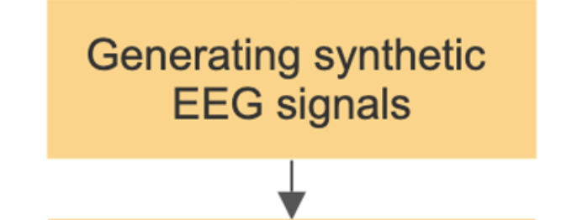

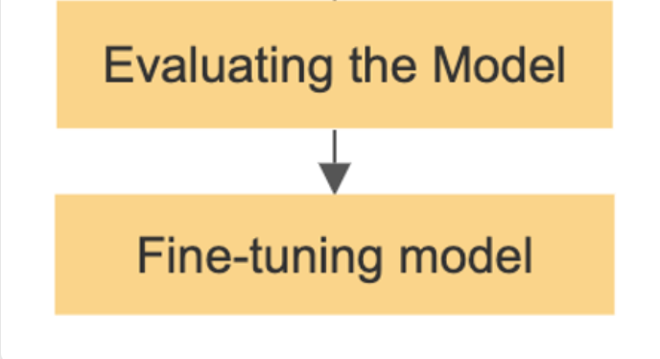
2
Pipeline Progression
Department of
Biomedical Informatics
Notes:
create a signal that has similar statistical properties to the real data with IF

Slide 4
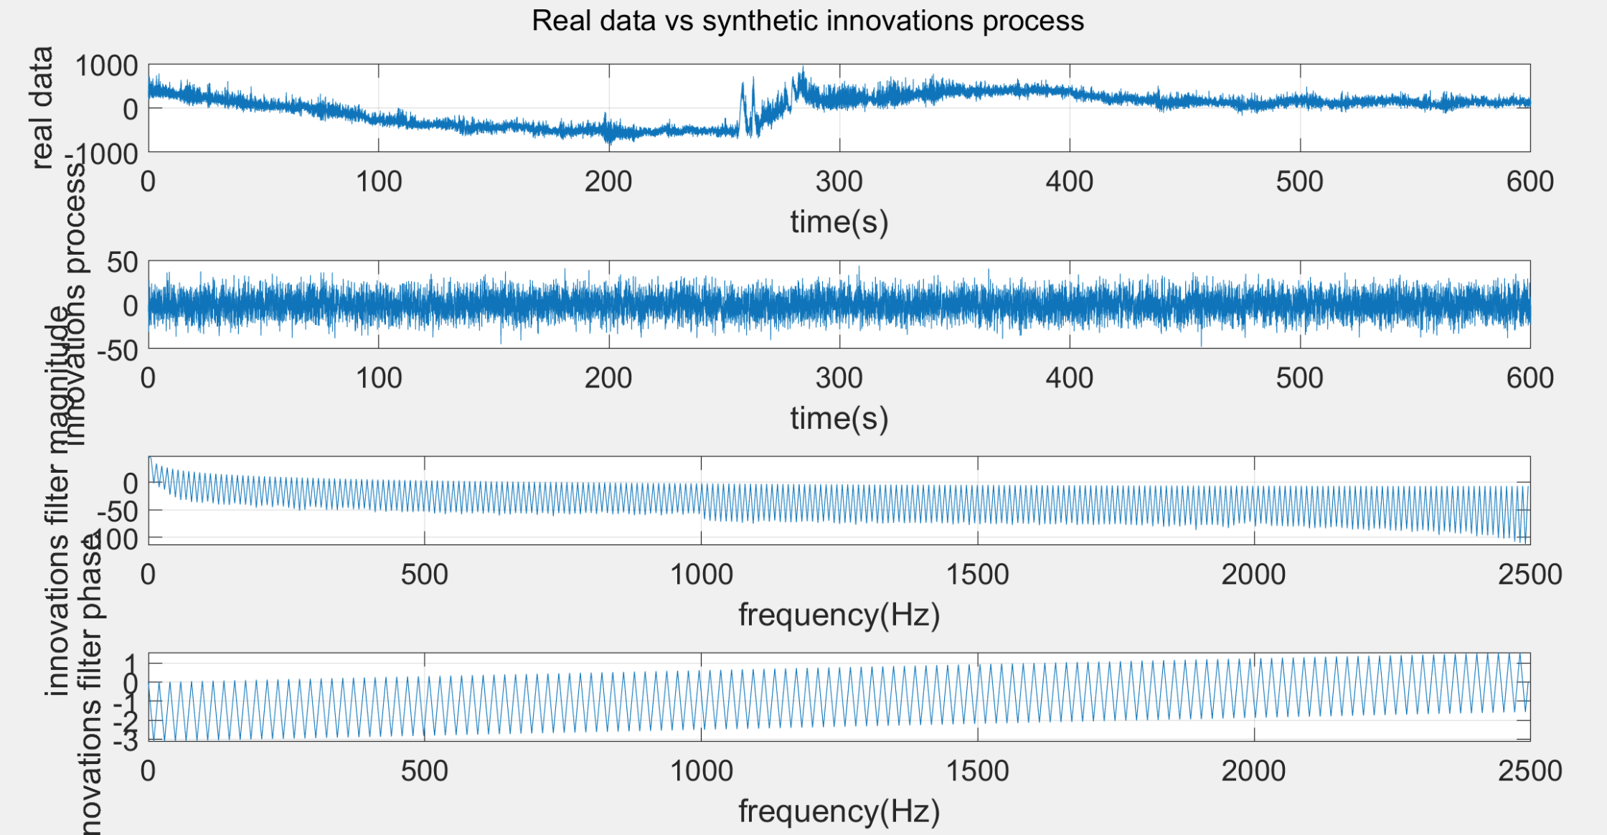
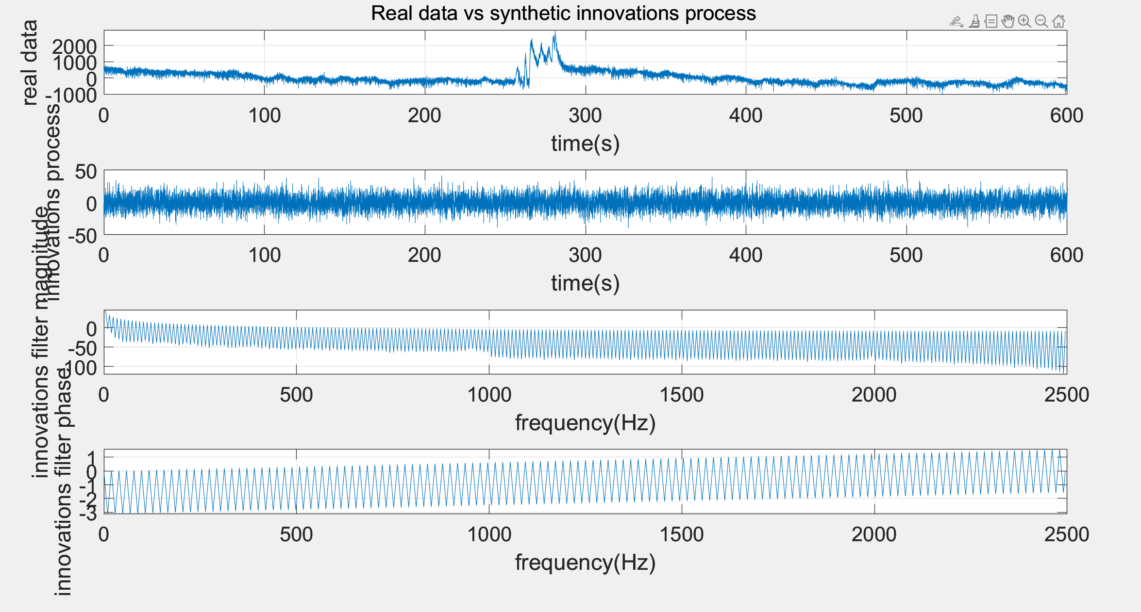
2
Time vs Frequency Domain
Department of
Biomedical Informatics

Slide 5
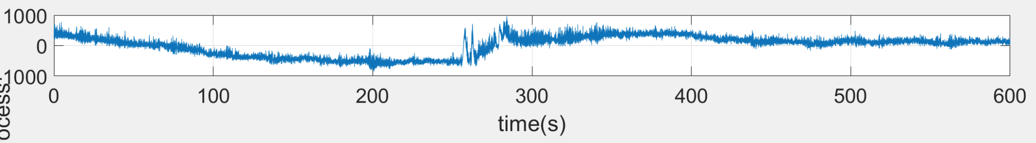
2
Time vs Frequency Domain
Real Data
original time-domain signal of the EEG channel
should show typical EEG waveform characteristics, such as distinct oscillatory patterns in various frequency bands (e.g., delta, theta, alpha, beta, and gamma)
appearance of the real data plot will depend on the specific data set and the selected channel
Department of
Biomedical Informatics

Slide 6
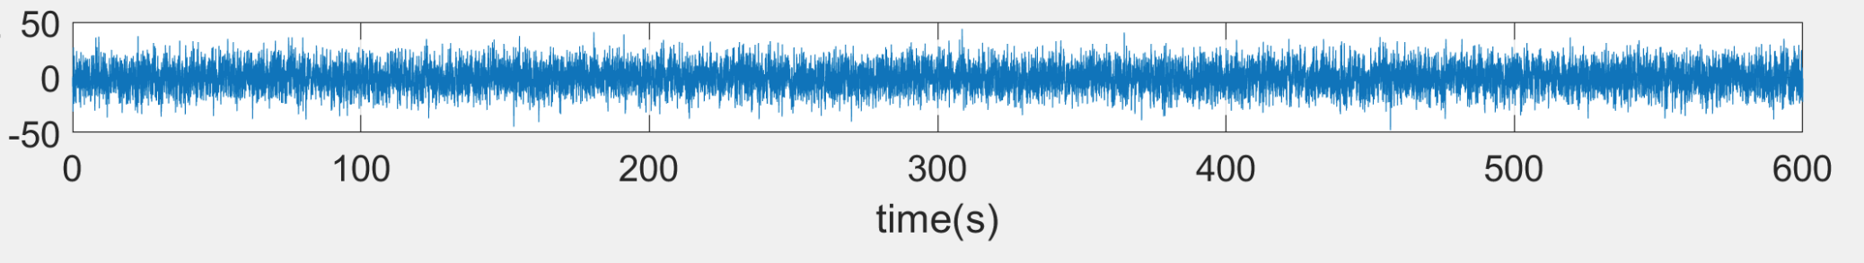
2
Time vs Frequency Domain
Innovations Process – Synthetic Data
synthetic time-domain signal generated using the innovations filter
innovations process is a white noise signal -> filtered to mimic properties of real EEG data
may not visually look like the real data because the IF captures just second-order statistical properties (i.e., power spectral density) of the real data
does not replicate higher-order statistics/ waveform shapes present in the real data
more like random noise (with some structure) rather than a replica of the real EEG signal
Department of
Biomedical Informatics

Slide 7
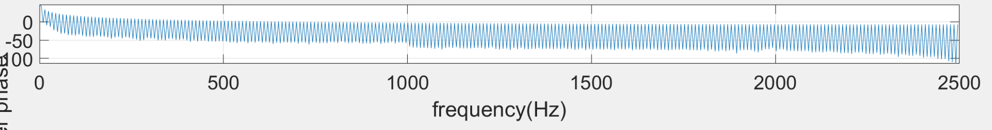
2
Time vs Frequency Domain
IF Magnitude
illustrates the magnitude response of the innovations filter in the frequency domain
represents the frequency components the filter is emphasizing or attenuating to convert the white noise input (innovations process) into a signal that resembles the real data's statistical properties
magnitude response should highlight dominant frequency bands present in the real data
Department of
Biomedical Informatics

Slide 8
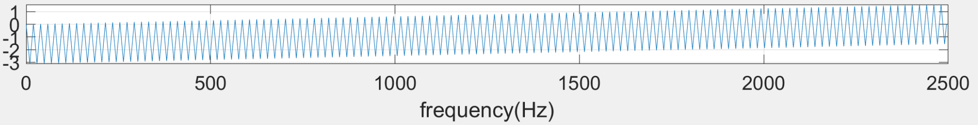
2
Time vs Frequency Domain
IF Phase
demonstrates the phase response of the innovations filter in the frequency domain
phase response provides information on the phase shift introduced by the filter at each frequency
Selected linear-phase filter to preserve the waveform's shape
Department of
Biomedical Informatics

Slide 9
2
Time vs Frequency Domain
IF Phase
demonstrates the phase response of the innovations filter in the frequency domain
phase response provides information on the phase shift introduced by the filter at each frequency
Selected linear-phase filter to preserve the waveform's shape
Department of
Biomedical Informatics

Slide 10
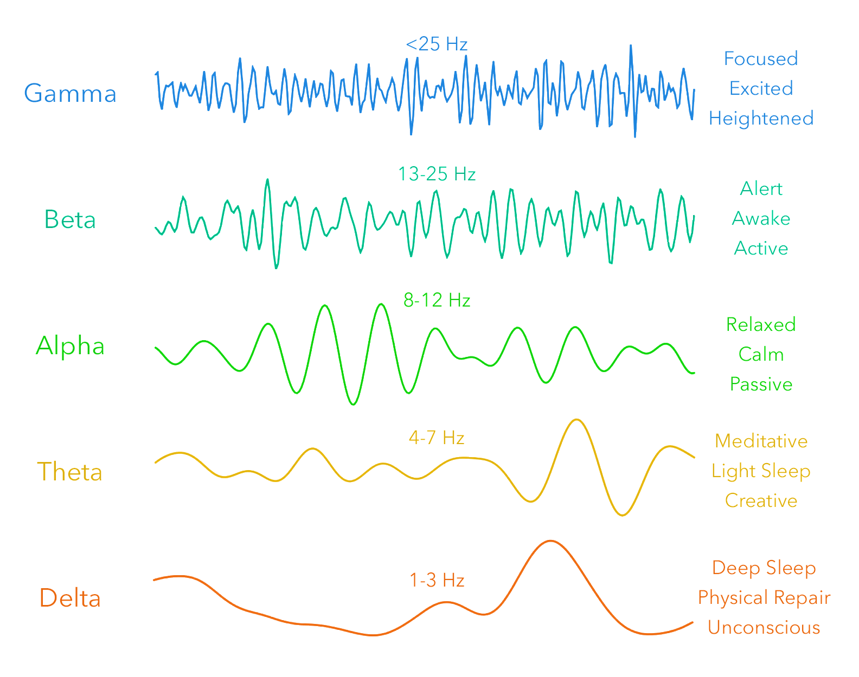
2
Time vs Frequency Domain
Department of
Biomedical Informatics

Slide 11
7
Feedback
Thank you for your attention
Last Updated: Mar 14, 2023
Department of
Biomedical Informatics

